Slide 1


Molten Salt Energy Carrier Model Informed by the Pair Distribution Function
Jacob Numbers¹, Anthony Birri², Nick Termini², Tyler Hamm¹, Troy Munro¹
¹Brigham Young University, Provo, UT
²Oak Ridge National Laboratories, Oak Ridge, TN
Notes:
Jake Numbers, Master’s student BYU

Slide 2
Presentation Outline
Molten Salt Thermal Conductivity
Previous Predictive Models
Conclusion
Measurement Efforts
Model of Energy Carriers
Notes:
Previous models: empirical to first-principles, solid to gas spectrums, issues (actinides)

Slide 3
Molten Salt Thermal Conductivity

Slide 4
Foundational Challenges
Known thermo-physical properties
Accurate modeling
Optimized salt selection
Licensed MSR designs
Competitive energy cost
Mix and temp-dependent models
Effect of nuclear fuel on molten salts
Molecular models of molten salts
Optimizing salt selection for MSRs requires characterization of thermophysical properties
Viscosity
Density
Heat Capacity
Thermal Conductivity
If measurements can’t serve as a shortcut, models can provide parameterized support
Models require validation with measurements
Property estimation,
Fitting methods
Bulk property measurements
Liquid thermal theories
Validation
Notes:
Thousands of salt options, have to consider impact on chemical stability, melting/boiling points, transport properties, neutronics, corrosion potential, availability/cost, waste management, and thermal properties
Necessitates property confidence across numerous compositions and temperatures
Build this characterization of references measurements, but where limited, can provide theoretical property models
Our research deals with measuring these properties for salts to capture composition and temp-dependence, and developing models, especially for actinides—ideal for GenIV+ reactor designs

Slide 5
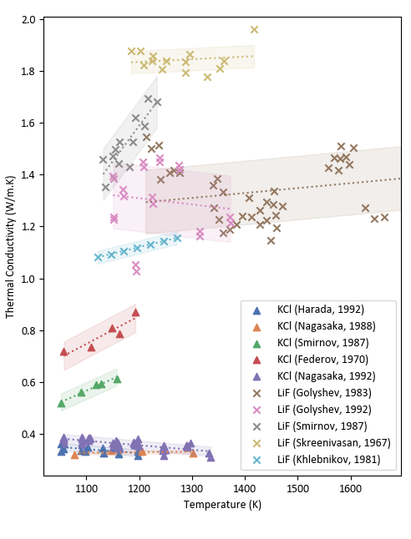
Thermal Conductivity
Thermal conductivity — least measured with largest measurement uncertainty in the Molten Salt Thermal Properties Database (MSTDB)¹
MSRs predicted to be especially sensitive to thermal conductivity^{2,3}
Need to build confidence in thermal conductivity characterization³⁴
Especially lacking actinide measurements
2 actinide-bearing salts
21 thermal conductivity measurements
801 salt compositions in database
18%
12%
9%
4%
Density
Viscosity
Thermal Conductivity
Heat Capacity
Thermal conductivity measurements of LiF and KCl^{4,5,6,7,8,24}
Notes:
Just heard the great work at ORNL on amassing thermophysical properties database for molten salts, includes density, viscosity, TC, heat capacity
Due to challenges of molten salt (corrosivity, electrical conductivity, high temp rad/convection effects), TC especially hard
Very sparse (only 2 of 801 salts in database are actinides with measurements)
Uncertainty is relatively high
Modeled scenarios of heat transfer coefficient shows TC especially influential.
In a fueled molten salt reactor, composition and temps subject to change and so we want to be confident in how resultant thermal conductivity changes

Slide 6
Dual Objectives
Improve measurement accuracy
Validate estimation models
Validate measurements
Improve estimation confidence
Obtain Measurements
Measurements across compositional range of mixtures
Extend to actinide-bearing salts
A robust, confident description of molten salt thermal conductivity should relate measurable parameters of salt compounds to a temperature- and composition-dependent thermal conductivity
Develop Models
Evaluate models in comparison with measurements
Adapt/develop models for actinides
Notes:
Our work takes assumes the best is to develop measurements and models side by side, ideally getting lots of data for a given salt across a compositional range

Slide 7
Measurement Efforts

Slide 8
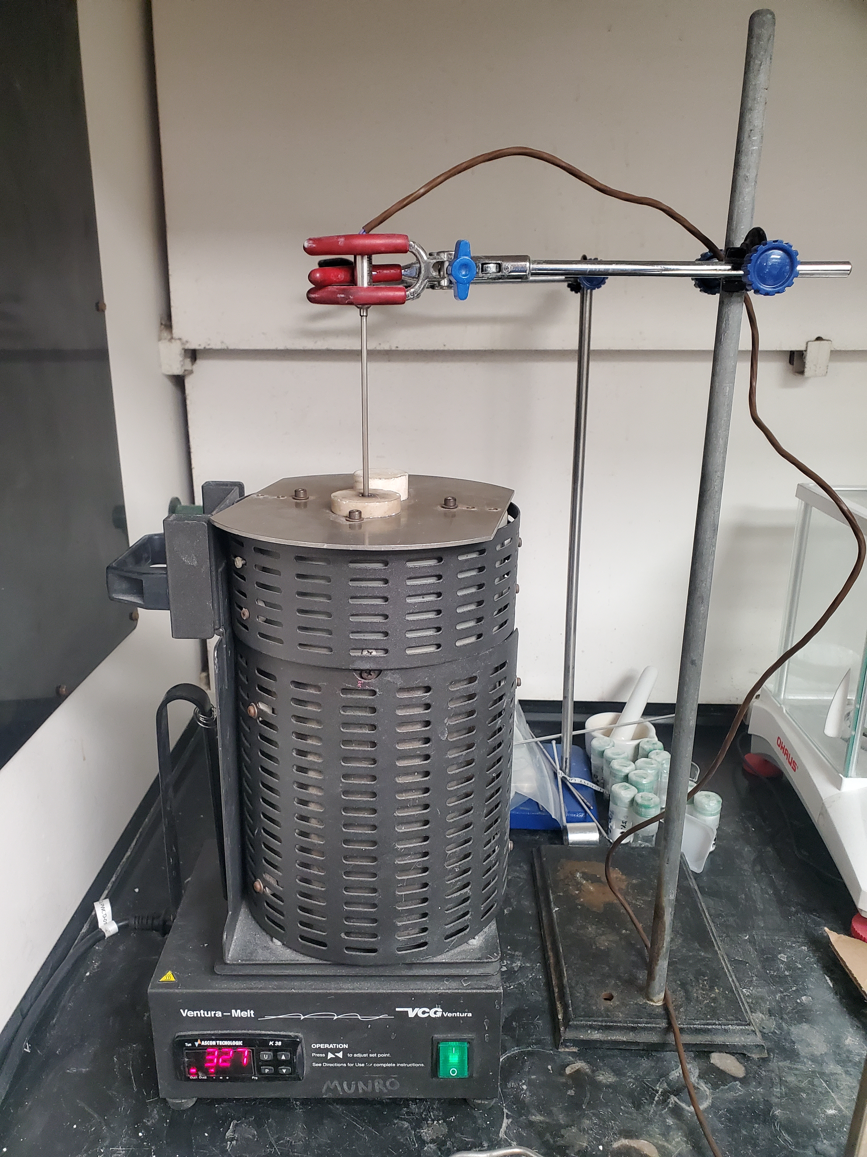

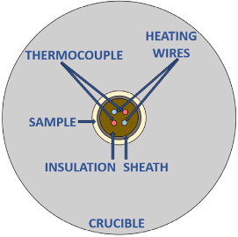
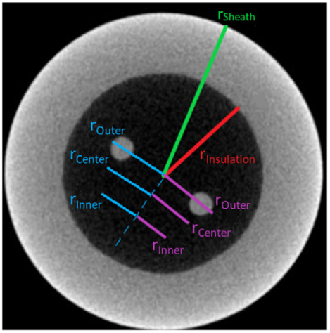
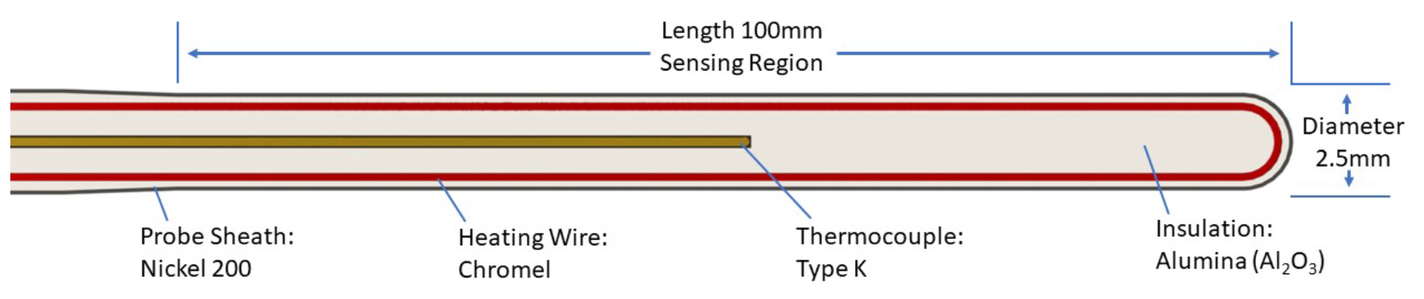
Needle Probe
Modified combination of concentric cylinders and transient hot wire methods:
Method | Modification | Improvement | Challenges
Concentric Cylinders | Thinner sample annulus (<0.7mm) | Minimize convection and sample size (<3g) | Highly sensitive to concentricity
 | Transient (vs steady-state) | Reduce axial-to-radial losses, shorter test times | Requires complex analytical modeling
Transient Hot Wire | Insulated wires | Reduce EMI and corrosion | Increases test time (order of 10s vs 1s)
 | Thermocouple (vs resistance thermometer) | Fast response time, robust design | EMI through insulation possible at high temperatures

Slide 9
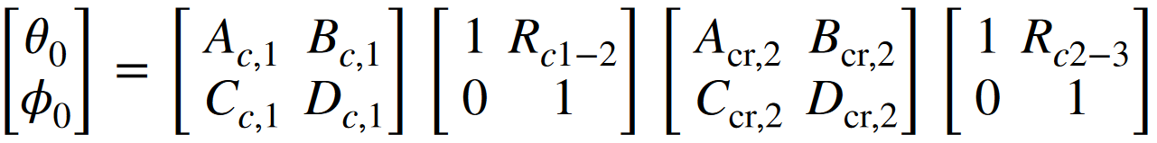
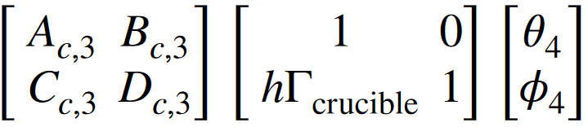
Measurement Process – Needle Probe
1. Prepare salt composition for measurement
2. Electrically insulated thermocouple measures transient response to Joule heating in heater wire
3. Thermal quadrupoles analytical model is solved for thermal conductivity of salt to match temperature profiles from data and model
4. Test repeated across temperature range of salt to obtain temperature dependence of salt composition thermal conductivity

Slide 10
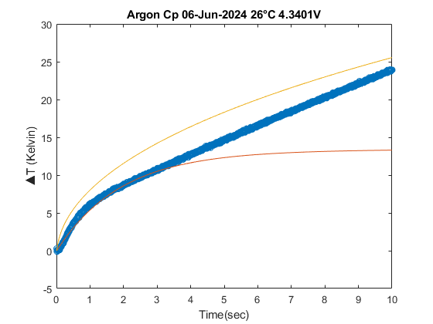
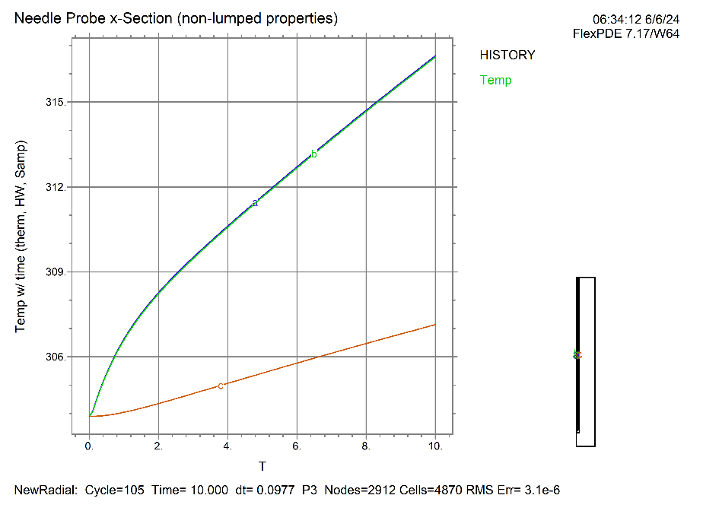
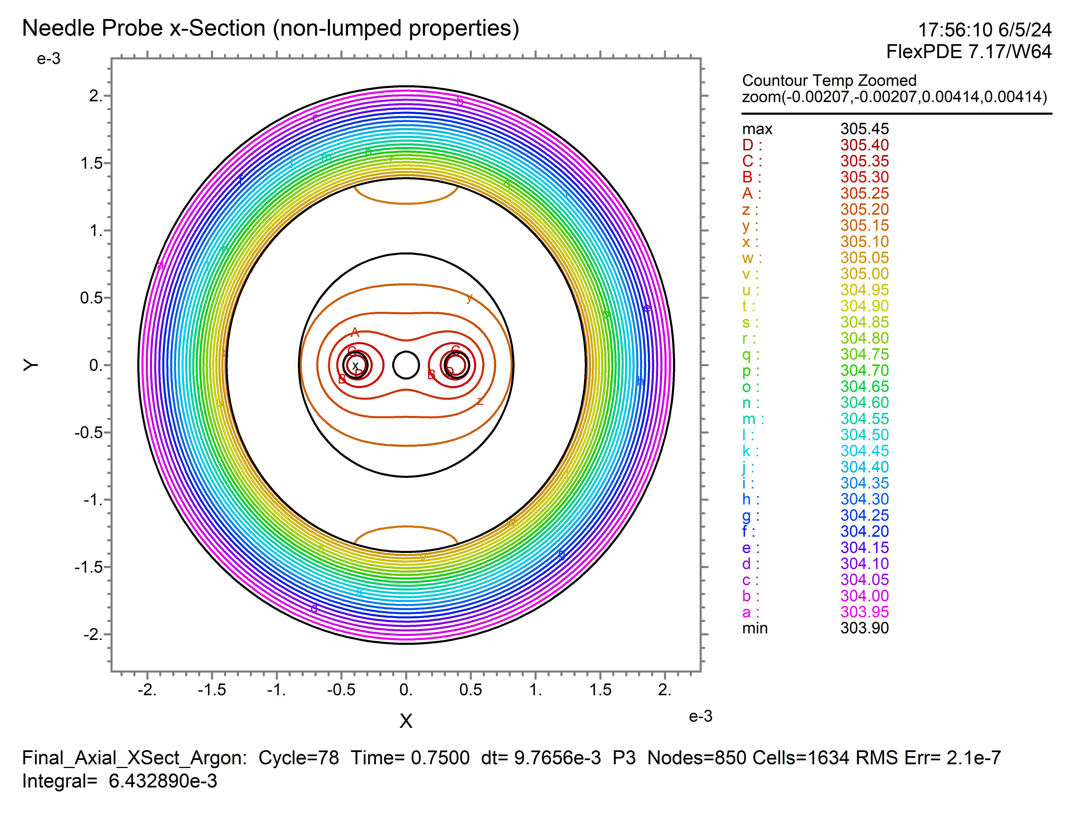
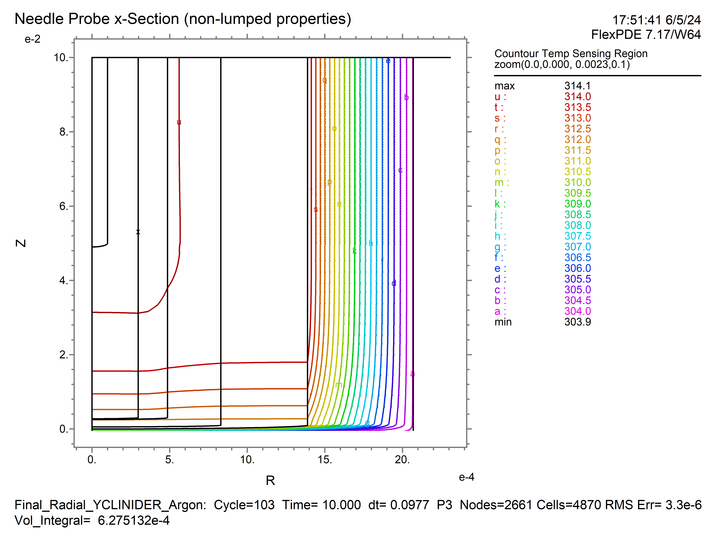
Needle Probe Development
Analytical model with predicted λ
Argon experimental data, 27ºC
Solving for Probe Properties
Collected Argon test data (inert glovebox atmosphere) to solve for probe thermal behavior with known λ_{Argon}
Spans entire temperature range to capture temp-dependent behavior of probe
Due to low λ_{Argon} ≈ 0.03, must account for axial heat diffusion (2-D vs 1-D)
Modeling
FlexPDE – fast PDE solver to produce analytical temp profile with 2-D model
Allows higher fidelity of internal probe properties
Comparing horizontal vs vertical cross-section to verify assumptions
Can be iteratively integrated in MATLAB solution code
Analytical model fitted for λ
FlexPDE solution – With thermal contact resistance at insulation-sheath boundary
Thermocouple
Insulation
Sample
Temperature profile at thermocouple
Thermocouple
Heating Wire
Sheath
Insulation
Sheath
Crucible
Sample
Heating Wires
Crucible
Notes:
Ryan Ruth, Troy Munro

Slide 11
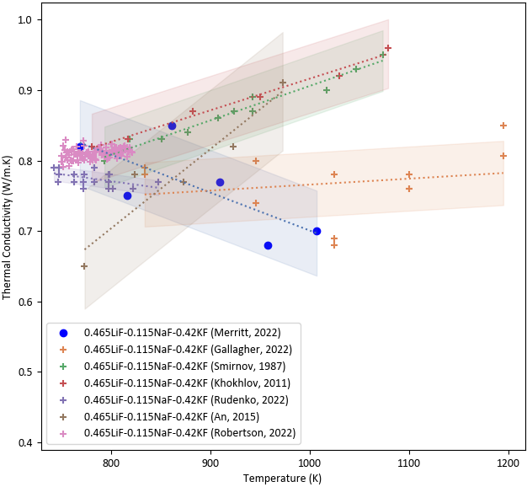
Measurements
Due to the minimal required sample size, fast measurement times, and repeatability of apparatus, the needle probe can support collection of multiple salt compositions to capture temperature dependency
Measurements can be validated with methods capable of higher temperatures (variable gap apparatus) or higher accuracy
FLiNaK Comparison
Not considering inherent accuracy of method (i.e. CC suspected to be subject to radiation or convection losses) or setup times
Arbitrary, but illustrates relative contribution of NP throughput
Future NP development to increase temp range and accuracy
Ideal
FLiNaK Measurement Temperature Range (K)
VGA
CC
NP
Size according to avg. standard deviation of data
Needle Probe (NP)
LFA
Variable Gap Apparatus (VGA)
Concentric Cylinders (CC)
Concentric Cylinders (CC)
Laser Flash Analysis (LFA)
TGS
Laser Flash Analysis (LFA)
Transient Grating Spectroscopy (TGS)
weeks
days
hours
minutes
seconds

Slide 12
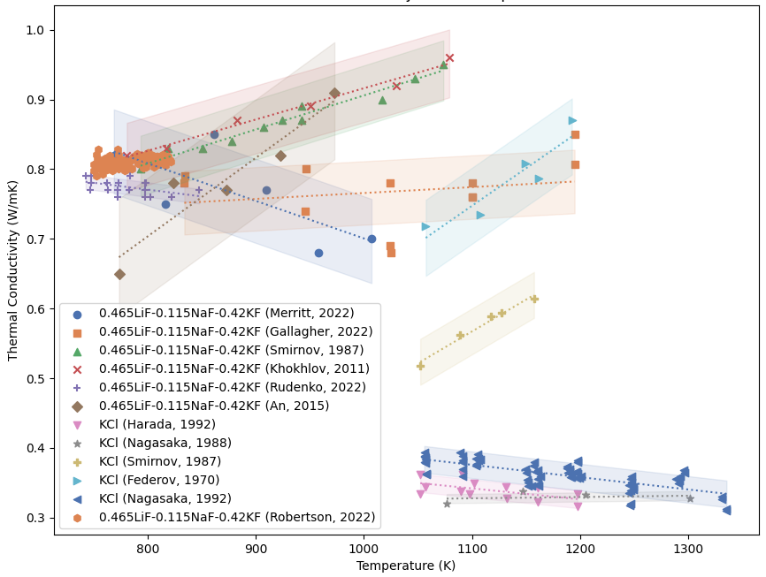
Temperature Dependence
Lack of conclusive temperature dependence in experimental molten salt λ
Fluoride salts particularly difficult to measure due to reactivity with SiO₂ (LFA, TGS, FRS methods)
Variation attributed to unaccounted radiation/convection losses in measurement method
Yet no conclusive liquid energy transfer description, but proposed theories suggest negative trend
Need to develop theory for liquid thermal conductivity for molten salts to test predictions with measurements
References 9,10,11,12,15,16,17,14,35,36
Notes:
Important to define the reason for the temperature dependence, still not conclusively agreed upon but by most accounts it should be negative
Measurements see positive correlations suggested due to unaccounted heat losses

Slide 13
Thermal Conductivity Predictive Models

Slide 14
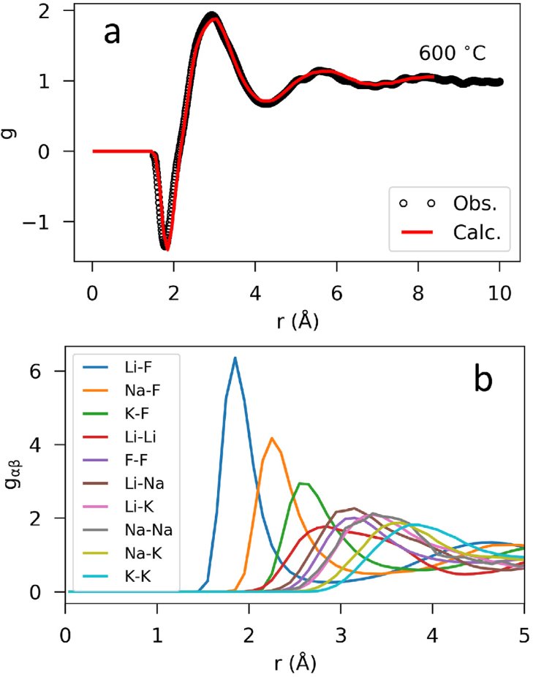
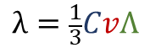
Predicting Thermal Conductivity
How is energy stored and propagated in a liquid? How does this change with composition and temperature?
More like solids than gases:
Short-range ordering (SRO) evident in molten salts from pair distribution function (PDF) data
Energy carriers—phonon quasi-particles
Derivation of thermal conductivity via energy carriers:
Heat capacity, group velocity, mean free path (MFP) in one dimension for isotropic medium
For solids/liquids, dependent on phonon density of states, altered by phonon scattering, etc.
How do we model this for molten salts?
Kinetic Theory of Gases
Dilute system – limited intermolecular interactions
Energy stored in individual molecules
Transferred via collisions, proportional to molecular MFP
Energy Transfer in Liquids?
$$λ=\frac{1}{3}CvΛ$$
Phonon Physics of Solids
Strong intermolecular interactions
Energy stored in vibration packets—phonons
Transferred via phonons, proportional to phonon MFP
Experimental and modeled PDF of molten FLiNaK.
B. A. Frandsen et al. Journal of Nuclear Materials (2020)¹⁸
^{See references 19,20}
Notes:
Short-range ordering (SRO) evident in molten salts from XRD and MD pair distribution function (PDF) data
Most models assumes MFP on order of average sum of radii

Slide 15
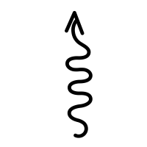
Estimation Approaches
Macroscopic
Thermodynamics
 | Liquid Theory |  |  |  |  | Fitting Methods
 | Phonon Gas Model (Zhao, 2021) (PGM) | Kinetic Theory (Gheribi) |  | Bridgman-type | Chapman-Enskog | Corresponding states, semi-empirical models
 |  | 2014 Empirical Fit (Kt_{emp}) | 2023 Cahill-Poll λ_{min} (KT_{CPλ})
Summary | Thermal conductivity described by phonon modes, approximated by macro-properties | Relates thermal conductivity to ionic radius proportionality by fitting to KCl data (Nagasaka, 1992) | Scales the Cahill-Poll minimum thermal conductivity according to anion complexity | Dilute gas interactions in a cubic lattice, relates λ to variation in free volumes/angles | Energy transfer occurs via collisions, modified with density and viscosity | Underlying thermal behavior follows across states of matter and certain materials
Temperature Dependence | Negative Based on temp-dependent sound velocity and density | Negative Based on thermal expansivity at melting point scaled with temperature change and composition |  | Negative Based on temp-dependent sound velocity and density | Negative Based on temp-dependent viscosity estimation | Matches temp-dependent behavior of fitted data
Limitations | Unknown phonon freq. distribution requires use of thermodynamic properties | Requires fitting to empirical data to scale the phonon mean free path relationship | Increased deviation with highly complex and polymerizing mixtures | Does not consider dissociated interatomic behavior (prevalent in molten salt ions) | Does not capture the temperature dependence of salts. | May not be able to extrapolate for salt and compositional variation.
Solids
Dilute Gas
Molecular Interactions
Microscopic
See references 21,22,23,24,25,26,27,28,
Comparing latest attempts (Gheribi’s kinetic theory-derived model and Zhao’s phonon gas model) can provide insights into relationships and parameters that capture molten salt thermal conductivity.

Slide 16
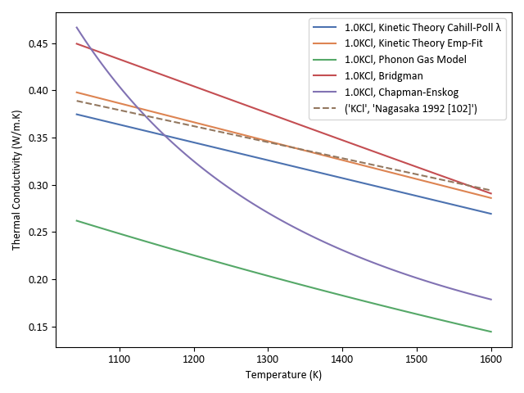
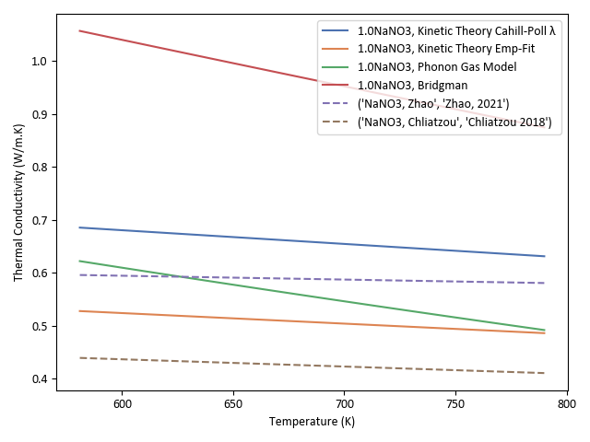
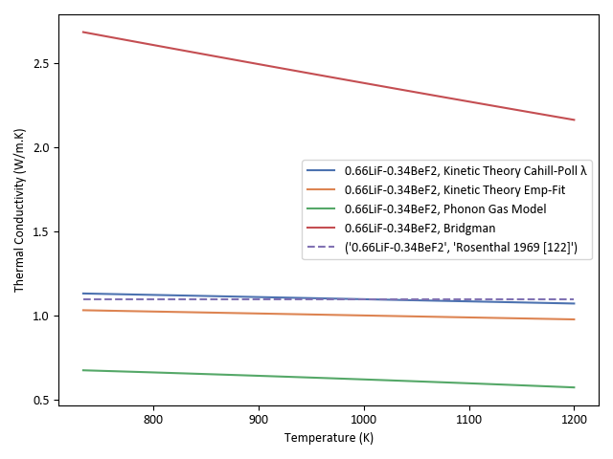
Model Analysis
KT_{emp} uses a fitting constant from Nagasaka’s KCl data to limit melting point thermal conductivity for ionic systems
KT_{CPλ} scales the minimum λ according to salt complexity, match closely for most systems
Are these models overly sensitive to ionic radius?
Gheribi observed increasing degradation with increasing difference in radii for KT
Polyatomic nature of NaNO₃ structure may increase phonon scattering events
Bridgman overestimates with increasing complexity—possibly failing to capture loss of momentum in phonon scattering events (non-momentum-conserving)
^{See references 1,29,30}
Notes:
The nitrate ion (NO3-) has a relatively low charge density being a large polyatomic anion with a single negative charge. This results in weaker ionic interactions and lower lattice enthalpies compared to smaller, highly charged ions. The lower lattice energy makes it easier for the nitrate salts to dissociate when molten. –Perplexity

Slide 17
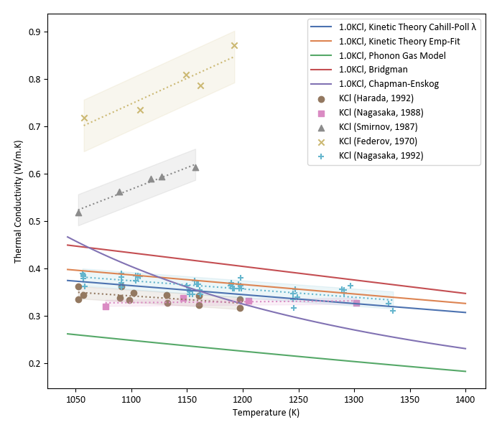
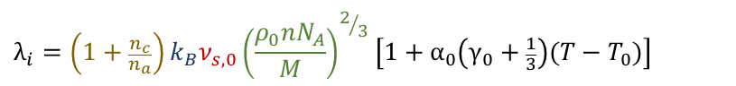
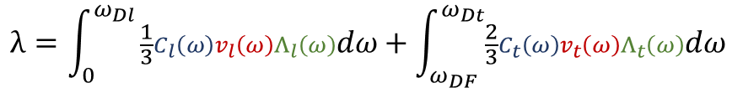
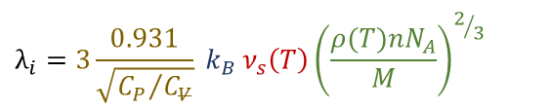
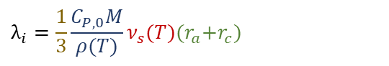
Model Analysis
Models attempt to describe thermal conductivity in terms of a scale factor of energy storage, group velocity, and MFP of energy carriers
Temp-varying modifier
Gheribi Kinetic Theory, Cahill-Poll λ_{min} (KT_{CPλ}):
$$λ_{i}={\left(1+\frac{n_{c}}{n_{a}}\right)k_{B}ν}_{s,0}{\left(\frac{ρ_{0}nN_{A}}{M}\right)}^{2/3}\left[{1+α}_{0}\left({\text{γ}}_{0}+\frac{1}{3}\right)({T−T}_{0})\right]$$
Zhao Phonon Gas Model (PGM):
$$λ_{i}=\frac{1}{3}{\frac{C_{P,0}M}{ρ(T)}ν}_{s}(T){(r}_{a}+r_{c})$$
$$λ_{i}={3\frac{0.931}{\sqrt{{C_{P}}/{C_{V}}}}{ k}_{B} ν}_{s}\left(T\right){\left(\frac{ρ(T)nN_{A}}{M}\right)}^{2/3}$$
Bridgeman-type:
While Bridgman-type methods simulate pure salts better than Zhao’s PGM, the latter is studied because of its approximation of the description of phonon frequency-dependent thermal conductivity:
Model performance relative to measurements can provide clues to extend modeling capability to actinide-bearing salts.
2 transverse phonon modes (generally negligible in liquids)
1 longitudinal phonon mode
$$λ=\int_{0}^{ω_{Dl}}{\frac{1}{3}C_{l}\left(ω\right)v_{l}\left(ω\right)Λ_{l}\left(ω\right)dω+\int_{ω_{DF}}^{ω_{Dt}}{\frac{2}{3}C_{t}\left(ω\right)v_{t}\left(ω\right)Λ_{t}\left(ω\right)dω }}$$

Slide 18
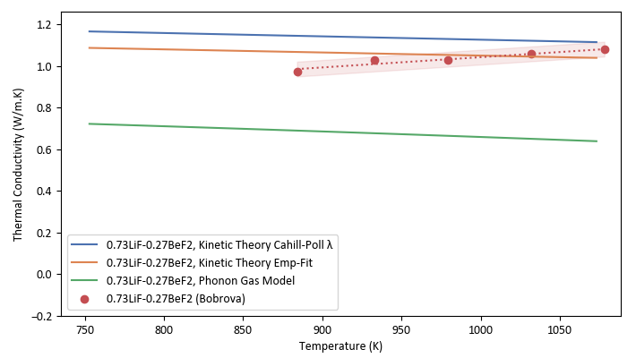
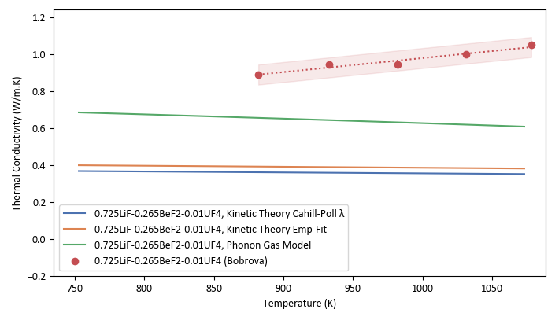
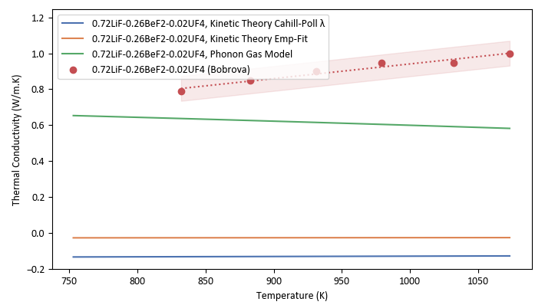
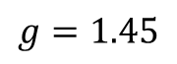
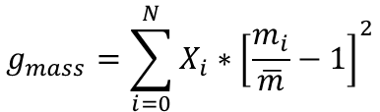
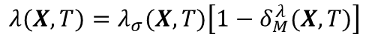
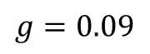
Modeling Actinides
Compositional Variation
KT methods build compositional dependency using a modifier to ideal conductivity, with a factor of mass fluctuation
$$λ(X,T)=λ_{σ}(X,T)\left[1−δ_{M}^{λ}(X,T)\right]$$
$$g_{mass}=\sum_{i=0}^{N}{X_{i}∗{\left[\frac{m_{i}}{\overline{m}}−1\right]}^{2}}$$
KT performs well with ions of similar molar masses, but degrades with increasing disparity of molar mass, providing unrealistic estimations for actinides
FLiBe
FLiBe+2%UF₄
$$g=0.09$$
$$g=1.45$$
PGM underpredicts most λ, but approaches measured value with increased actinide presence. Why?
What we need:
More actinide data with compositional/temperature variation
Develop modeling ability for actinides
M_{UF4} = 314 g/mol
M_{LiF} = 25.9 g/mol
^{Reference 31}
Notes:
Lattice thermal conductivity degradation may include other significant factors in addition to mass variation.
To extend predictive models to actinide-bearing mixtures, these must be developed to handle large molecular mass differences.

Slide 19
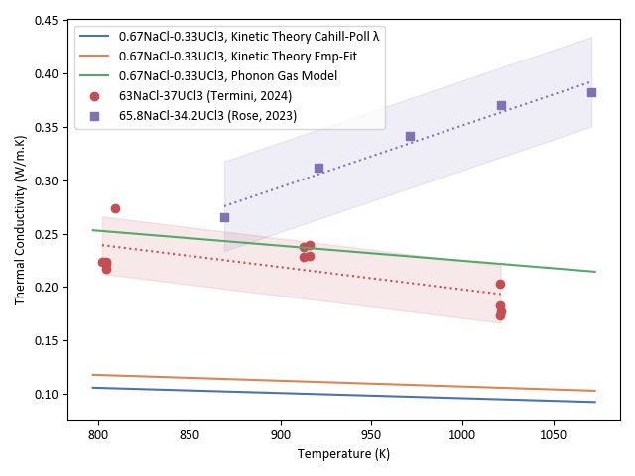
Actinide Measurements and Models
NaCl-UCl3
Measurements of NaCl-UCl3 (63-37mol%) were recently conducted at ORNL using the Variable Gap Apparatus³³. Laser flash analysis measurements at Argonne National Laboratory obtained similar reference values at melting temperature³².
KT methods underestimate measured values due to mass fluctuation term
PGM matches measurements most closely
Why does PGM underestimate alkali halides but approach measured values for nitrates and actinide-bearing salts?
What effect does ion dissociation and complexing have on effective thermal conductivity?
How should we develop these models to capture molten salt thermal conductivity for actinides?
Measured C_{P}, v_{sound} similar uncertainty across salts—is the MFP ≈ sum of ionic radii for actinides/complexing salts, but greater for dissociating alkali-halides?
We need more actinide salt measurements that capture composition and temperature dependency
Notes:
I had the priviledge of helping conduct thermal conductivity measurements of NaCl-UCl3 using the variable gap apparatus, which was designed by Ryan Gallagher. It’s been developed by Nick Termini and the team at ORNL to include an extensive Helium calibration method to better characterize it’s measurements. Can provide large temperature range and a confident temperature due to its inherent variable gap design.
These measurements of a similar salt were also conducted using LFA at Argonne national laboratory, which obtains similar reference values at the melting temperature.
KT underestimates these for reasons we just discussed, but note how PGM matches closely with measurements.
Now, why does PGM underestimate pure alkali-halides and mixtures but appropriately predict higher concentrations of actinides? Again, the biggest assumption we think we make with PGM (and most models really) is in calculating the mean free path. PGM puts it simply at the interatomic distance, it may be that this becomes more accurate for complexing salts with actinides.
Obtaining more compositional studies of actinide salts that capture the temperature dependency is vital to answering these questions.

Slide 20
New PDF-informed Thermal Conductivity Model

Slide 21
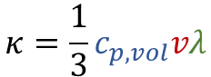
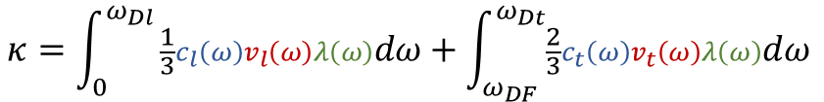
Phonon Gas Model
2 transverse phonon modes (generally negligible in liquids, high Frenkel frequency)
1 longitudinal phonon mode
Characterizing Energy Carriers
$$κ=\int_{0}^{ω_{Dl}}{\frac{1}{3}c_{l}\left(ω\right)v_{l}\left(ω\right)λ\left(ω\right)dω+\int_{ω_{DF}}^{ω_{Dt}}{\frac{2}{3}c_{t}\left(ω\right)v_{t}\left(ω\right)λ\left(ω\right)dω }}$$
What measurable parameters characterize the dominant energy carriers?
$$κ=\frac{1}{3}c_{p,vol}vλ$$
Assuming effective properties of energy carriers, neglecting transverse modes
 | Specific Heat Capacity | Group Velocity | Mean Free Path
Metric | Measured bulk volumetric specific heat | Measured adiabatic speed of sound | PDF structural coherence length
Reasoning | Successful heat capacity model links phonon states to liquid characteristics^{[1]}. | The macroscopic limit of longitudinal modes give rise to the adiabatic sound velocity; | Short-range vibrational modes are dominant energy transfer medium^{[6]}—the average structural coherence length is proportional to short-range order
Questions | Low velocity modes contribute to heat capacity but not thermal conductivity^{[2]}—provides an upper bound | Molten salts do support shear modes and faster group velocities at very small wavelengths corresponding to interatomic distances^{[3,4]}. | How do we obtain the effective structural coherence length from the PDF? How is the coherence of energy transfer affected by structure and liquid diffusion?
 | Populations of transverse modes appear to be very small in proportion to longitudinal modes; these may be considered negligible^{[5]}
[1] K. Trachenko, “Heat capacity of liquids: An approach from the solid phase,” Phys. Rev. B, vol. 78, no. 10, p. 104201, Sep. 2008, doi: 10.1103/PhysRevB.78.104201.
[2] D. G. Cahill, S. K. Watson, and R. O. Pohl, “Lower limit to the thermal conductivity of disordered crystals,” Phys. Rev. B, vol. 46, no. 10, pp. 6131–6140, Sep. 1992, doi: 10.1103/PhysRevB.46.6131.
[3] K. Trachenko, Theory of Liquids: From Excitations to Thermodynamics. Cambridge: Cambridge University Press, 2023. doi: 10.1017/9781009355483.
[4] F. Demmel, S. Hosokawa, and W. C. Pilgrim, “Collective particle motions in molten KCl,” Journal of Alloys and Compounds, vol. 452, no. 1, pp. 143–148, Mar. 2008, doi: 10.1016/j.jallcom.2006.10.167.
[5] A. Z. Zhao, M. C. Wingert, R. Chen, and J. E. Garay, “Phonon gas model for thermal conductivity of dense, strongly interacting liquids,” Journal of Applied Physics, vol. 129, no. 23, Jun. 2021, doi: 10.1063/5.0040734.
[6] K. Cornwell, “The thermal conductivity of molten salts,” J. Phys. D: Appl. Phys., vol. 4, no. 3, p. 441, Mar. 1971, doi: 10.1088/0022-3727/4/3/313.
Notes:
I had the priviledge of helping conduct thermal conductivity measurements of NaCl-UCl3 using the variable gap apparatus, which was designed by Ryan Gallagher. It’s been developed by Nick Termini and the team at ORNL to include an extensive Helium calibration method to better characterize it’s measurements. Can provide large temperature range and a confident temperature due to its inherent variable gap design.
These measurements of a similar salt were also conducted using LFA at Argonne national laboratory, which obtains similar reference values at the melting temperature.
KT underestimates these for reasons we just discussed, but note how PGM matches closely with measurements.
Now, why does PGM underestimate pure alkali-halides and mixtures but appropriately predict higher concentrations of actinides? Again, the biggest assumption we think we make with PGM (and most models really) is in calculating the mean free path. PGM puts it simply at the interatomic distance, it may be that this becomes more accurate for complexing salts with actinides.
Obtaining more compositional studies of actinide salts that capture the temperature dependency is vital to answering these questions.

Slide 22
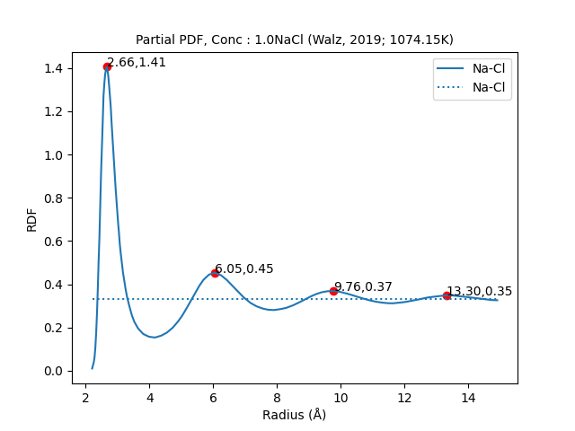
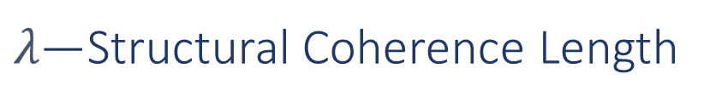
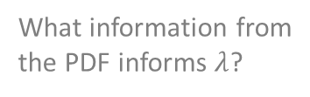
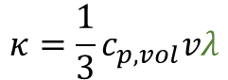
$λ\text{—}$Structural Coherence Length
Interpreting the Pair Distribution Function
Thermal energy transferred
Energy must be redistributed wherever structural coherence ends
Bulk number density
Assumptions:
Energy carriers (phonons, sequential ion collisions, etc.) will propagate as long as its medium remains coherent.
Cation-anion pairs are dominant medium in energy transfer (strongest bonds, charge-ordering)
Structural coherence length is proportional the degree of short-range order in molten salts.
Energy carriers will maintain an average heat capacity and propagation speed as far as the medium remains coherent—what contributes to coherent medium?
Some portion continues to the extent of a coherent medium
Concentration of ion pair
$$κ=\frac{1}{3}c_{p,vol}vλ$$
What information from the PDF informs $λ$?

Slide 23
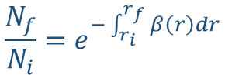
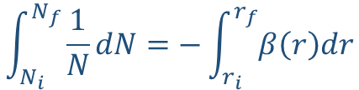
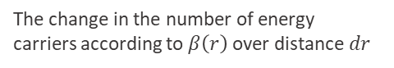
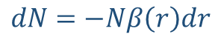
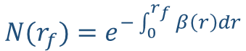
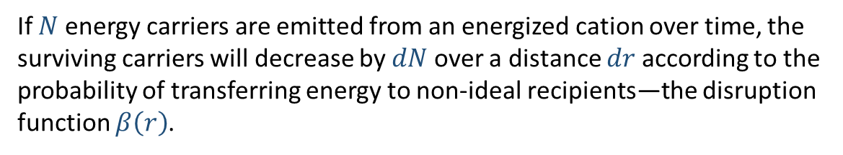
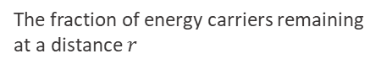
$λ\text{—}$Structural Coherence Length
To obtain a unit of length, we need to describe the change in transferred energy carriers with distance.
Contributions to Coherence
Posited rules for coherency:
The ideal recipients of energy carriers are oppositely charged ions separated by distance of interaction potential minima
Decoherence results in the transfer of energy to system—new energy carriers
Interacting with a non-ideal recipient breaks coherence. Non-ideal recipients include:
Same-charge ions
Dissimilar cations from the originating cation
Dissimilar anions from the original recipient anion
Out-of-phase transfer
If $N$ energy carriers are emitted from an energized cation over time, the surviving carriers will decrease by $dN$ over a distance $dr$ according to the probability of transferring energy to non-ideal recipients—the disruption function $β\left(r\right)$.
$$dN=−Nβ\left(r\right)dr$$
The change in the number of energy carriers according to $β\left(r\right)$ over distance $dr$
$$\int_{N_{i}}^{N_{f}}{\frac{1}{N}dN}=−\int_{r_{i}}^{r_{f}}{β\left(r\right)dr}$$
Rearranging and solving for the number of energy carriers as a function of radius
$$\frac{N_{f}}{N_{i}}=e^{−\int_{r_{i}}^{r_{f}}{β\left(r\right)dr}}$$
The fraction of energy carriers remaining at a distance $r$
$$N(r_{f})=e^{−\int_{0}^{r_{f}}{β\left(r\right)dr}}$$
If at r_{i} = 0, N_{i} = 1, the number of energy carriers can be described by an exponential decay function of r_{f}

Slide 24
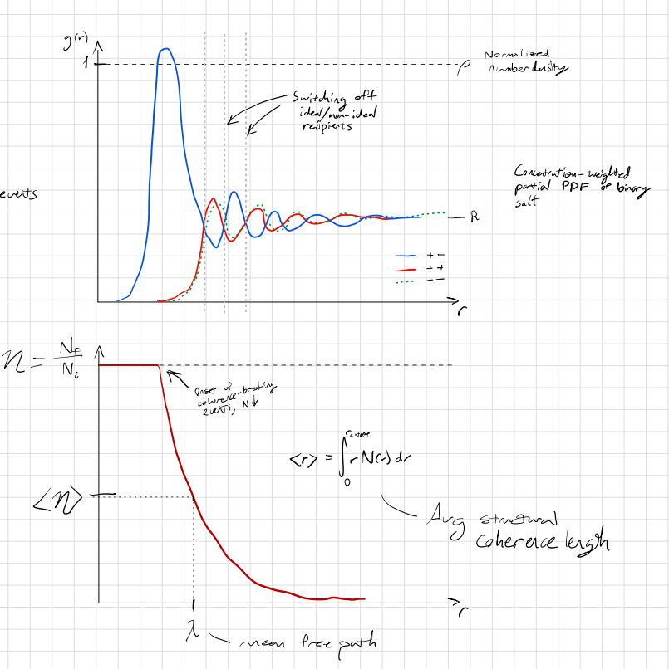
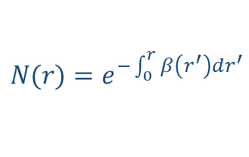
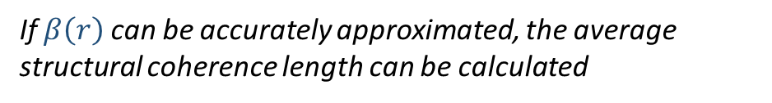
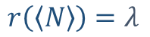
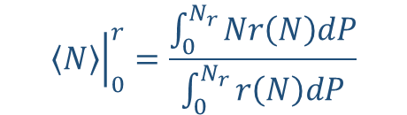
$λ\text{—}$Structural Coherence Length
Contributions to Coherence
$$N(r)=e^{−\int_{0}^{r}{β\left(r^{′}\right)dr^{′}}}$$
$${\left.\left\langle N\right\rangle \right|}_{0}^{r}=\frac{\int_{0}^{N_{r}}{Nr\left(N\right)dP}}{\int_{0}^{N_{r}}{r\left(N\right)dP}}$$
The effective probability over the integrated distance
The radius corresponding to the effective probability is equal to the average structural coherence length
$$r\left(\left\langle N\right\rangle \right)=λ$$
If $β\left(r\right)$ can be accurately approximated, the average structural coherence length can be calculated
Replace with better image

Slide 25



$λ\text{—}$Structural Coherence Length
Attempts and Issues
Errors:
Calculated the function $β\left(r\right)$ by simply taking continuous difference of ideal to non-ideal recipient PDFs
This doesn’t scale the disruption function physically, and sequential vibrations do not pass through every point. Their jumps are quantized.
Assumed that the subsequent peaks corresponded to energy potential minimum with respect to the reference ion, but these are dictated by packing density.
The ideal transfer distance will still be the first cation-anion peak position, though subsequent chains will be weighted by probabilities of aligned ions with r
Attempts to improve model:
Base everything off of relative quantities to avoid having to make empirical calculations
Discretize vibrational energy transfer jumps
Account for potential diffusion to decrease vibrational transfer efficiency and extend reach of final transfer
Need to weight specific heat and speed of sound contributions for each ion pair for final thermal conductivity calculation

Slide 26








$λ\text{—}$Structural Coherence Length
Scaling Contributions to Decoherence
$$dN=−Nβ\left(r\right)dr$$
$dN$ is equal to $−N$ when $Nβ\left(r\right)dr=0$, or when $β\left(r\right)→∞$
If the energy transferred remains coherent only along a cation-anion chain, we need to find the factors that affect the probability of that chain existing as a function of radius and express them as a ratio between 0 and 1.
The ideal recipient will switch with each step (from cation to anion to cation, etc.) and the only transfer length that maintains coherence according to our assumptions is the first peak distance, which corresponds to the separation distance of the interaction potential minima. This configuration maintains in-phase vibrational transfer.
Possible factors for $b_{n}$:
$b_{NI}$: Non-ideal recipient probability in each sequence (dependent only on the first peak)
$b_{RT}$: Relative vibrational energy transfer inefficiency in each sequence (dependent only on the first coordination shell)
$b_{SRO}$: Recipient density in succeeding sequence due to SRO decay
To not require an empirical value for decoherent factors ranging from 0 to ∞, we can define relative decoherence factors $b_{n}$as a ratio between 0 and 1, which cause $β\left(r\right)→0$ or $∞$ for each limit.
$$β\left(r\right)=\sum_{n}^{N}{\frac{b_{n}}{1−b_{n}}}$$
If multiple relative decoherence factors are present, then the sum of their expressions for $β\left(r\right)$ allow each to either cause $β\left(r\right)→∞$ or have no effect
 | All carriers stop at r | No carriers stop at r
$$β$$ | ∞ | 0
$$b$$ | 1 | 0
Only if all $b=0$

Slide 27






$λ\text{—}$Structural Coherence Length
$$N(r′)=e^{−\int_{0}^{r^{′}}{β\left(r\right)dr}}$$
Disruption Function $β\left(r\right)$
$b_{NI}$: Non-ideal recipient probability in each sequence (dependent only on the first peak)
$b_{RT}$: Relative vibrational energy transfer inefficiency in each sequence (dependent only on the first coordination shell)
$b_{SRO}$: Recipient density in succeeding sequence due to SRO decay
Subsequent peaks are not determined by interaction potential with central ion—dictated by packing density
$$b_{NI}=1 − \frac{g_{ideal}(r_{peak})}{g_{total}(r_{peak})}$$
$$b_{RT}=1 − \frac{g_{+−}\left(r_{peak}\right)−g_{+−}\left(r_{minima}\right)}{g_{+−}\left(r_{peak}\right)}$$
Non-zero first minima indicates relative affinity for diffusion
$$b_{SRO}=1 − \frac{g_{ideal}(r_{i})}{g_{ideal}(r_{i−1})}$$
Most efficient separation distance for vibrational energy transfer. The first peak corresponds to energy minima with respect to central ion at r = 0

Slide 28








$λ\text{—}$Structural Coherence Length
Disruption Function $β\left(r\right)$
$$b_{NI}=1 − \frac{g_{ideal}(r_{peak})}{g_{total}(r_{peak})}$$
$$b_{RT}=1 − \frac{g_{+−}\left(r_{peak}\right)−g_{+−}\left(r_{minima}\right)}{g_{+−}\left(r_{peak}\right)}$$
$$b_{SRO}=1 − \frac{g_{ideal}(r_{i})}{g_{ideal}(r_{i−1})}$$

Slide 29



$λ\text{—}$Structural Coherence Length
$$N(r′)=e^{−\int_{0}^{r^{′}}{β\left(r\right)dr}}$$
Disruption Function $β\left(r\right)$
If the energy transferred along a cation-anion chain is directly proportional to the density of ideal and non-ideal recipients, a first approximation of the interaction function can be made:
The maximum possible density of energy carriers emitted from a reference cation is proportional to
$$β\left(r\right)=\left(1−\frac{w_{ideal}\left(r\right)−w_{non}\left(r\right)}{{\left.w_{ideal,max}\right|}_{0}^{r}}\right)\left(\frac{w_{non}\left(r\right)}{w_{ideal}\left(r\right)+w_{non}\left(r\right)}\right)$$
$$β\left(r\right)=\left\{\begin{aligned}\left(1−\frac{w_{ca}\left(r\right)−w_{cc}\left(r\right)}{{\left.w_{ca,max}\right|}_{0}^{r}}\right)\left(\frac{w_{cc}\left(r\right)}{w_{ca}\left(r\right)+w_{cc}\left(r\right)}\right), \text{if} w_{ca}\left(r\right)≥w_{ca}\left(r→∞\right) \\ &\left(1−\frac{w_{cc}\left(r\right)−w_{ca}\left(r\right)}{{\left.w_{cc,max}\right|}_{0}^{r}}\right)\left(\frac{w_{ca}\left(r\right)}{w_{cc}\left(r\right)+w_{ca}\left(r\right)}\right), \text{if} w_{ca}\left(r\right)<w_{ca}\left(r→∞\right)\end{aligned}\right.$$
Because the ideal recipient ion switches consecutively between cation and anion, a switching function alternates when it crosses beneath its concentration (used to approximate the effective bond length).
The cumulative integral interaction function $β\left(r\right)$ can then be used to describe the decay of energy carriers according to the SRO given by the PDF.

Slide 30





$λ\text{—}$Structural Coherence Length
$$P(r)=e^{−\int_{0}^{r_{max}}{β\left(r\right)dr}}$$
Continuous $β\left(r\right)$- Comparison to Measurement
Further perturbations can be added to 𝛽(𝑟) to account for additional factors of coherency.
Maximum possible initial energy carriers transferred (by first peak height)
Change in energy transfer efficiency—highly dependent on ion separation distance (though the PDF does implicitly maximize 𝛽(𝑟) between ions, resembling the increased decay rate)
Challenges:
Potential for "rebounded" energy carriers, where no recipient is in position to receive the carrier.
Does not capture behavior of multiple cation-anion pairs in mixtures
Model prediction of $λ_{P(r)}$ exceeds the back-calculated values $λ_{BC}$ of unary alkali halide salts by 3-20%
May be estimated by the combined Debye-modified Coulomb and Leonard-Jones potential
The cumulative integral interaction function $β\left(r\right)$ can then be used to describe the decay of energy carriers according to the SRO given by the PDF.

Slide 31
$λ\text{—}$Structural Coherence Length
$$P(r)=e^{−\int_{0}^{r_{max}}{β\left(r\right)dr}}$$
Discrete Interaction Function $β\left(r\right)$
Model prediction of $λ_{P(r)}$ exceeds the back-calculated values $λ_{BC}$ of unary alkali halide salts by 3-20%
The cumulative integral interaction function $β\left(r\right)$ can then be used to describe the decay of energy carriers according to the SRO given by the PDF.

Slide 32
While the first peak distance corresponds to the energy minima between cation and anion—where repulsive and attractive forces balance—consecutive peaks exist due to the packing arrangement probability. If the most significantly dominant transfer medium is a sequential chain of cations and anions separated by the distance corresponding to their minimum interaction potential,

Slide 33

$λ\text{—}$Structural Coherence Length
$$P(r)=e^{−\int_{0}^{r_{max}}{β\left(r\right)dr}}$$
Estimating the Interaction Function $β\left(r\right)$
If the energy transferred along a cation-anion chain is directly proportional to the density of ideal and non-ideal recipients, a first approximation of the interaction function can be made:
The maximum possible density of energy carriers emitted from a reference cation is proportional to
$$β\left(r\right)=\left(1−\frac{w_{ideal}\left(r\right)−w_{non}\left(r\right)}{{\left.w_{ideal,max}\right|}_{0}^{r}}\right)\left(\frac{w_{non}\left(r\right)}{w_{ideal}\left(r\right)+w_{non}\left(r\right)}\right)$$
$$β\left(r\right)=\left\{\begin{aligned}\left(1−\frac{w_{ca}\left(r\right)−w_{cc}\left(r\right)}{{\left.w_{ca,max}\right|}_{0}^{r}}\right)\left(\frac{w_{cc}\left(r\right)}{w_{ca}\left(r\right)+w_{cc}\left(r\right)}\right), \text{if} w_{ca}\left(r\right)≥w_{ca}\left(r→∞\right) \\ &\left(1−\frac{w_{cc}\left(r\right)−w_{ca}\left(r\right)}{{\left.w_{cc,max}\right|}_{0}^{r}}\right)\left(\frac{w_{ca}\left(r\right)}{w_{cc}\left(r\right)+w_{ca}\left(r\right)}\right), \text{if} w_{ca}\left(r\right)<w_{ca}\left(r→∞\right)\end{aligned}\right.$$
Because the ideal recipient ion switches consecutively between cation and anion, a switching function alternates when it crosses beneath its concentration (used to approximate the effective bond length).
The cumulative integral interaction function $β\left(r\right)$ can then be used to describe the decay of energy carriers according to the SRO given by the PDF.

Slide 34
Conclusions
Future Work
Molten salt thermophysical measurement and models need to develop together
Molten salts require all innovative measurements and robust models available
Liquid thermal theory could provide insights beyond molten salts
We need more measurements across compositions and temperatures, especially regarding actinide-bearing mixtures
Measure across compositions:
FLiNaK-UF₄
NaCl-UCl₃
CLiNaK system (LiCl-KCl)
Develop predictive thermal conductivity model for actinide-bearing salts
Measuring electrical conductivity to compare to increase in diffusivity with dual-purpose probe (Walz and Spoel, 2019, p. 18522)
Notes:
In summary, models and measurements need to grow up together. All methods are valuable, since non is standardized and each has advantages and limitations
Salts are challenging to measure and model, but these obstacles require innovate measurement methods and models—it’s a proving ground for liquid thermal theory that can extend beyond molten salts.
We need compositionally and temperature dependent data.
Our future measurements include compsitions of FLiNaK system with UF4 and the CLiNaK system, with validation of key mixtures via a collaboration with ORNL.
Our end goal is to provide/develop confident thermal conductivity characterization for actinide bearing salts.

Slide 35


Acknowledgements
Funding for this research has come from the Department of Energy, Nuclear Energy University Program (NEUP): Award #DE-NE0009502.
Anthony Birri and Nicholas Termini are supported by the Molten Salt Reactor Program and the Nuclear Energy Advanced Modeling and Simulation Program under the US Department of Energy’s Office of Nuclear Energy.
Meaningful discussions with Benjamin Frandsen and Matthew Asplund also provided valuable direction for the project. The authors are also grateful for the assistance of Tyler Hamm, Britton Baltich, Isaac Cutler, and Lizzy Robinson in compiling and interpreting data for this work.
Presentation slides

Slide 36
References
Oak Ridge National Laboratory, U. of South Carolina, T. Besman, N. D. B. Ezell, T. Birri, N. Termini, S. Henderson, and J. Schorne-Pinto. (2024) Molten salt thermal properties database. [Online]. Available: https://mstdb.ornl.gov/
Creasman, Sarah. “Sensitivity Analysis of Thermophysical Properties of Molten Salts Using a Molten Salt Demonstration Reactor Model in TRANSFORM.” Doctoral Dissertations, May 1, 2023. https://trace.tennessee.edu/utk_graddiss/8160.
Freile, Ramiro, and Mark Kimber. “Influence of Molten Salt-(FLiNaK) Thermophysical Properties on a Heated Tube Using CFD RANS Turbulence Modeling of an Experimental Testbed.” Edited by Jan Leen Kloosterman, Elsa Merle, and Jean Ragusa. EPJ Nuclear Sciences & Technologies 5 (2019): 16. https://doi.org/10.1051/epjn/2019027.
Golyshev, Vladimir D. “Experimental Investigation of the Thermal-Conductivity of Transparent Melts”, TVT, 21:5 (1983), 899–903; High Temperature, 21:5 (1983), 684–687,” 1983. https://www.mathnet.ru/php/archive.phtml?wshow=paper&jrnid=tvt&paperid=6160&option_lang=eng.
Golyshev, Vladimir D. “High-Temperature Thermophysical Properties of Nonscattering Semitransparent Materials I: Methods and Instrumentation for the Determination of Spectral Absorptivity and Thermal Conductivity of Melts,” no. 4 (1992): 367–77.
Khlebnikov, O. E., V. A. Sokolov, I. E. Veneraki, and A. N. Alabovsky. “Determination of Thermal Conductivity Coefficients of Lithium, Magnesium, Calcium, and Barium Fluorides in the Liquid State.” Thermophysical Properties of Substances 5 (1981): 97–101.
Harada, Makoto, Akihisa Shioi, Tsunetoshi Miura, and Shinsuke Okumi. “Thermal Conductivities of Molten Alkali Metal Halides.” Industrial & Engineering Chemistry Research 31, no. 10 (October 1, 1992): 2400–2407. https://doi.org/10.1021/ie00010a021.
Nagasaka, Y., and A. Nagashima. “Measurement of the Thermal Diffusivity of Molten KCl up to 1000°C by the Forced Rayleigh Scattering Method.” International Journal of Thermophysics 9, no. 6 (November 1, 1988): 923–31. https://doi.org/10.1007/BF01133260.
An, Xue-Hui, Jin-Hui Cheng, Hui-Qin Yin, Lei-Dong Xie, and Peng Zhang. “Thermal Conductivity of High Temperature Fluoride Molten Salt Determined by Laser Flash Technique.” International Journal of Heat and Mass Transfer 90 (November 1, 2015): 872–77. https://doi.org/10.1016/j.ijheatmasstransfer.2015.07.042.
Gallagher, Ryan C., Anthony Birri, Nick G. Russell, Anh-Thu Phan, and Aïmen E. Gheribi. “Investigation of the Thermal Conductivity of Molten LiF-NaF-KF with Experiments, Theory, and Equilibrium Molecular Dynamics.” Journal of Molecular Liquids 361 (September 1, 2022): 119151. https://doi.org/10.1016/j.molliq.2022.119151.
Khokhlov, V., I. Korzun, V. Dokutovich, and E. Filatov. “Heat Capacity and Thermal Conductivity of Molten Ternary Lithium, Sodium, Potassium, and Zirconium Fluorides Mixtures.” Journal of Nuclear Materials 410, no. 1 (March 1, 2011): 32–38. https://doi.org/10.1016/j.jnucmat.2010.12.306.
Merritt, Brian, Michael Seneca, Ben Wright, Noah Cahill, Noah Petersen, Austin Fleming, and Troy Munro. “Thermal Conductivity Characterization of Fluoride and Chloride Molten Salts Using a Modified Transient Hot-Wire Needle Probe.” International Journal of Thermophysics 43, no. 10 (August 10, 2022): 149. https://doi.org/10.1007/s10765-022-03073-2.
Nagasaka, Y., N. Nakazawa, and A. Nagashima. “Experimental Determination of the Thermal Diffusivity of Molten Alkali Halides by the Forced Rayleigh Scattering Method. I. Molten LiCl, NaCl, KCl, RbCl, and CsCl.” International Journal of Thermophysics 13, no. 4 (July 1, 1992): 555–74. https://doi.org/10.1007/BF00501941.
Robertson, Sean G., Ralph Wiser, Wonseok Yang, Dokyu Kang, Sungyeol Choi, Emilio Baglietto, and Michael P. Short. “The Curious Temperature Dependence of Fluoride Molten Salt Thermal Conductivity.” Journal of Applied Physics 131, no. 22 (June 8, 2022): 225102. https://doi.org/10.1063/5.0088059.
Rudenko, Alexey, Alexander Redkin, Evgeniya Il’ina, Svetlana Pershina, Peter Mushnikov, Yuriy Zaikov, Sergey Kumkov, Yalan Liu, and Weiqun Shi. “Thermal Conductivity of FLiNaK in a Molten State.” Materials 15, no. 16 (January 2022): 5603. https://doi.org/10.3390/ma15165603.
Smirnov, M. V., V. A. Khokhlov, and E. S. Filatov. “Thermal Conductivity of Molten Alkali Halides and Their Mixtures.” Electrochimica Acta 32, no. 7 (July 1, 1987): 1019–26. https://doi.org/10.1016/0013-4686(87)90027-2.
V. I. Fedorov, V. I. Machuev, “Thermal Conductivity of Fused Salts”, TVT, 8:4 (1970), 912–914; High Temperature, 8:4 (1970), 858–860. Accessed March 23, 2024. https://www.mathnet.ru/php/archive.phtml?wshow=paper&jrnid=tvt&paperid=7779&option_lang=eng.
Frandsen, Benjamin A., Stella D. Nickerson, Austin D. Clark, Andrew Solano, Raju Baral, Johnny Williams, Jörg Neuefeind, and Matthew Memmott. “The Structure of Molten FLiNaK.” Journal of Nuclear Materials 537 (August 15, 2020): 152219. https://doi.org/10.1016/j.jnucmat.2020.152219.
Giordano, Valentina M., and Giulio Monaco. “Fingerprints of Order and Disorder on the High-Frequency Dynamics of Liquids.” Proceedings of the National Academy of Sciences 107, no. 51 (December 21, 2010): 21985–89. https://doi.org/10.1073/pnas.1006319107.
Revere, M., and M. P. Tosi. “Structure and Dynamics of Molten Salts.” Reports on Progress in Physics 49, no. 9 (September 1986): 1001. https://doi.org/10.1088/0034-4885/49/9/002.
Cahill, David G., S. K. Watson, and R. O. Pohl. “Lower Limit to the Thermal Conductivity of Disordered Crystals.” Physical Review B 46, no. 10 (September 1, 1992): 6131–40. https://doi.org/10.1103/PhysRevB.46.6131.
Gheribi, A.E., A.T. Phan, and P. Chartrand. “A Theoretical Framework for Reliable Predictions of Thermal Conductivity of Multicomponent Molten Salt Mixtures: KCl-NaCl-MgCl2 as a Case Study.” Solar Energy Materials and Solar Cells 236 (2022). https://doi.org/10.1016/j.solmat.2021.111478.
Gheribi, Aïmen E., and Patrice Chartrand. “Thermal Conductivity of Molten Salt Mixtures: Theoretical Model Supported by Equilibrium Molecular Dynamics Simulations.” The Journal of Chemical Physics 144, no. 8 (February 26, 2016): 084506. https://doi.org/10.1063/1.4942197.
Gheribi, Aïmen E., Jesus A. Torres, and Patrice Chartrand. “Recommended Values for the Thermal Conductivity of Molten Salts between the Melting and Boiling Points.” Solar Energy Materials and Solar Cells 126 (July 1, 2014): 11–25. https://doi.org/10.1016/j.solmat.2014.03.028.
Kincaid, John F., and Henry Eyring. “Free Volumes and Free Angle Ratios of Molecules in Liquids.” The Journal of Chemical Physics 6, no. 10 (October 1, 1938): 620–29. https://doi.org/10.1063/1.1750134.
Nagasaka, Y., and A. Nagashima. “Corresponding States Correlation for the Thermal Conductivity of Molten Alkali Halides.” International Journal of Thermophysics 14, no. 4 (July 1, 1993): 923–36. https://doi.org/10.1007/BF00502115.
Yang, Huiqiang, Ryan Gallagher, Patrice Chartrand, and Aïmen E. Gheribi. “Development of a Molten Salt Thermal Conductivity Model and Database for Advanced Energy Systems.” Solar Energy 256 (May 15, 2023): 158–78. https://doi.org/10.1016/j.solener.2023.04.009.
Zhao, Andrew Z., Matthew C. Wingert, Renkun Chen, and Javier E. Garay. “Phonon Gas Model for Thermal Conductivity of Dense, Strongly Interacting Liquids.” Journal of Applied Physics 129, no. 23 (June 21, 2021). https://doi.org/10.1063/5.0040734.
Chliatzou, Ch. D., M. J. Assael, K. D. Antoniadis, M. L. Huber, and W. A. Wakeham. “Reference Correlations for the Thermal Conductivity of 13 Inorganic Molten Salts.” Journal of Physical and Chemical Reference Data 47, no. 3 (September 19, 2018): 033104. https://doi.org/10.1063/1.5052343.
Zhao, Andrew Z., Matthew C. Wingert, and Javier E. Garay. “Frequency-Domain Hot-Wire Measurements of Molten Nitrate Salt Thermal Conductivity.” Journal of Chemical & Engineering Data 66, no. 1 (January 14, 2021): 262–70. https://doi.org/10.1021/acs.jced.0c00621.
Bobrova, K. O., V. N. Dokutovich, and P. N. Mushnikov. “Thermophysical Properties of Several Molten Mixtures of the LiF–BeF2–UF4 System.” Russian Metallurgy (Metally) 2023, no. 2 (February 1, 2023): 126–35. https://doi.org/10.1134/S0036029523020039.
Rose, M. A., L. D. Gardner, T. T. Lichtenstein, S. A. Thomas, and E. Wu. “Property Measurements of NaCl-UCl3 and NaCl-KCl-UCl3 Molten Salts (Rev.1).” Argonne National Laboratory (ANL), Argonne, IL (United States), May 26, 2023. https://doi.org/10.2172/1985295.
Termini, N. Birrit, T. Ezell, D. [Forthcoming] “Thermal conductivity measurements of NaCl-UCl3 using the variable gap apparatus.” Oak Ridge National Laboratory (ORNL), Oak Ridge, TN (United States). April, 2023.
Q. Zheng, M. Hao, R. Miao, J. Schaadt, and C. Dames, “Advances in thermal conductivity for energy applications: a review,” vol. 3, no. 1, p. 012002, publisher: IOP Publishing. [Online]. Available: https://dx.doi.org/10.1088/2516-1083/abd082
Chen, Gang. “Perspectives on Molecular-Level Understanding of Thermophysics of Liquids and Future Research Directions.” Journal of Heat Transfer 144, no. 010801 (November 9, 2021). https://doi.org/10.1115/1.4052657.
Trachenko, Kostya. “Heat Capacity of Liquids: An Approach from the Solid Phase.” Physical Review B 78, no. 10 (September 5, 2008): 104201. https://doi.org/10.1103/PhysRevB.78.104201.

Slide 37
Additional Slides

Slide 38



Needle Probe
Solves multi-layer heat diffusion equation for λ and c_{p} (and ρ if needed) to fit the analytical model to the temperature profile
Can select time frame for the fitting process according to regime most influenced by sample properties (from COMSOL sensitivity analysis)
Thermal quadrupoles to solve heat diffusion equations
Transform to Laplace space for solvable algebra
Solve for Laplace heat rate with Bessel functions
Adapt for layers system of equations
Numerically solve for sample properties to fit the analytical temperature to the temperature profile
λ_{sample}, c_{p,sample}, ρ_{sample}
Notes:
Merritt, Maillett

Slide 39



Model Performance
Comparison of FLiNaK model predictions using mixture values obtained via measurements or fundamental mixing rules.
Does the variation in model results sufficiently replicate measurement uncertainty?
KT uses fundamental mixing rules for property values (C_{p}, V_{m}, v_{sound})(cite Gallagher). These are applied to PGM for analysis.
M_{m} and v_{sound} dominant influential parameters in both Gheribi and Zhao models; molten salt sound velocity values are subject to significant uncertainty.
Gheribi’s Cahill-Poll λ_{min} provides best parameter sensitivity confinement
%Deviation of estimated properties using mixing rules from measured values for eutectic FLiNaK
 | KT_{emp} |  | KT_{CP} | PGM
v_{sound,m} | 15% |  |  | -2.1%
v’_{sound} (slope) |  |  |  | 21%
V_{m} | -15% |  |  | -1.3%
V’ (slope) |  |  |  | 14%
C_{p} | 15% |  |  | 15%
^{See reference 10}

Slide 40












Review - Kinetic Theory
Kinetic theory model works for ideal gases because there exists only one type of energy carrier with measurable average attributes (number density, velocity, volumetric heat capacity).
For generalized energy carriers, the problem becomes how to characterize and measure energy carriers.
Generalized Energy Carriers
Unit area
dA
Unit distance
dx
Unit distance travelled in unit time 𝑑𝑡 at average velocity ⟨𝑣⟩
$$dx=\left\langle v\right\rangle dt$$
Number density
$$n=\frac{\# energy carriers}{unit volume}$$
Unit volume in terms of average velocity
$$dV=dA⋅dx$$
x
$$dV=dA\left\langle v\right\rangle dt$$
y
z
Number of energy carriers (particles, phonons, etc.) that will cross plane of unit area $dA$ per unit time $dt$
$$N_{transfer}=\frac{n}{6}⋅dV⋅\frac{1}{dA}⋅\frac{1}{dt}$$
1/3 of particles will have motion in any given direction
$$\frac{1}{3}$$
$$\frac{1}{3}$$
$$\frac{1}{3}$$
x
y
z
$$N_{transfer}=\frac{n}{6}\frac{dA\left\langle v\right\rangle dt}{dA dt}$$
+x
-x
$$N_{transfer}=\frac{n\left\langle v\right\rangle }{6}$$
1/6 will be moving towards surface $dA$
$$\frac{1}{6}$$
$$\frac{1}{6}$$

Slide 41











Review - Kinetic Theory
Change in energy across unit plane per unit time—heat flux $q$
$$q={\left.\frac{n\left\langle v\right\rangle }{6} dE\right|}_{x+λ}^{x−λ}$$
Generalized Energy Carriers
Energy change proportional to definition of internal energy
$$dE∝dU=CdT$$
$$q=\frac{n\left\langle v\right\rangle }{6}C\left(T_{x+λ}−T_{x−λ}\right)$$
Mean free path before collision (energy transfer)
Hot
$$q=\frac{n\left\langle v\right\rangle }{6}C\left(T_{x}−\frac{∂T}{∂x}λ−T_{x}−\frac{∂T}{∂x}λ\right)$$
Taylor series of $T\left(x∓λ\right)$ about $x$
x+λ
x=0
$$q=−\frac{1}{3}Cn\left\langle v\right\rangle λ\frac{∂T}{∂x}$$
x-λ
$$c_{p}$$
Volumetric constant pressure specific heat capacity
x
$$q=−\frac{1}{3}c_{p}\left\langle v\right\rangle λ\frac{∂T}{∂x}$$
Heat flux $q$ in terms temperature gradient
Cold
y
z
Thermal conductivity in terms of energy carrier properties
$$κ=\frac{1}{3}c_{p}\left\langle v\right\rangle λ$$
To define $κ$, we need to characterize the effective heat capacity, group velocity, and mean free path of the energy carriers.

